Slide 1
Flame Detector RC car
Made by : Amr Hassan Mohamed
Notes:
<number>

Slide 2
Components
Arduino UNO
Bluetooth module HC05
L293D motor driver IC
Two DC motors
Two lithium batteries each 3.7 v
One 9v battery
Smartphone (any android will work)
Flame sensor module
Regulator 6v
Notes:
<number>

Slide 3
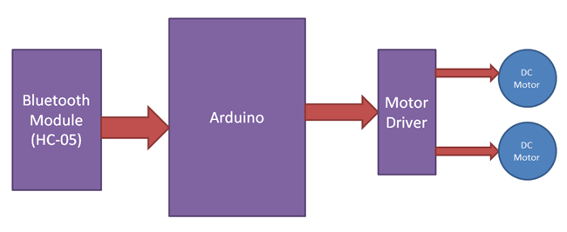
Basic operation
This describes the operation after sending messages using mobile app .
Notes:
<number>

Slide 4
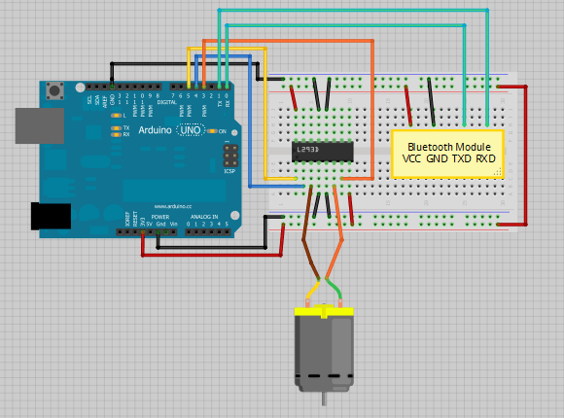
Schematic
Notes:
<number>

Slide 5
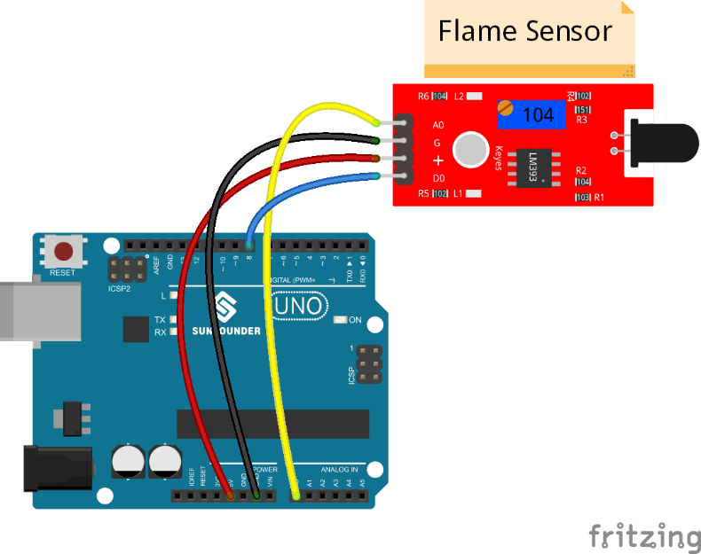
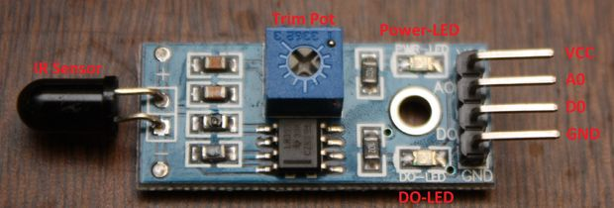
Flame Sensor
flame sensor is light up whenever there’s a flame or a lighter nearby

Slide 6

Mobile App
Mobile app is compatible with any device that support android but the version of the android has to be higher than or the same as Jelly Bean 4.1 version .

Slide 7
Problems and solutions
Sending multiple messages from mobile app
Synchronization
Operating the two motors with external battery
Multiple messages and Synchronization have been solved using recursive calls with each one has a delay to call the next one while the button is pressed and destroy all the remaining calls whenever the button have been released and the delay has to be alittle bit more than the delay of the Arduino .
Solved using two lithium batteries with regulator to ensure the proper voltage entering the motors and having the required current to run the motors
Notes:
<number>

Slide 8
Demo

Slide 9
Thank you
Notes:
<number>

